Slide 1
The Media Access Control Sublayer
Notes:
PAN：personal Area Network
在共享介质构成的网络环境下要解决的问题
该网络环境为：
1.以太网（通过一根有线电缆来将所有计算机连起来，那么这根电缆就是共享介质），任何一台计算机每时每刻都在接收电缆上的信息
传输问题：A、B机器想要同时发送数据，那么这根总线上哪个时刻是哪台计算机可以发送数据，规定一个时刻只能有一台计算机发送数据，时间片；
采用分时，必须要时间同步；
解决方法：不是有数据就发，不是在时间片的中间发，而是在时间片的一开始就发；
改进解决方法：窄波侦听，先不发送数据，通过侦听来看看别的计算机是不是已经在发送数据了，如果有机子在发就不发，减少发送信息的碰撞；但是因为发送延迟，可能也会碰撞
改进：
CSMA/CD
CD：冲突检测collision detect。1.如果计算机发送数据，一般连到这根线的其他计算机就不发送数据了，若检测不到发送的机子，另外的计算机可能以为通道空闲，然后就发送数据（因为会有时间延迟） 2.经过（什么的？）对比，发现不一样就说明受到了干扰，如果发送到一半受到干扰，那么剩下的信息就不再发送，这就是冲突检测。用于以太网中
发展：在以太网中用交换机
2.县城环网

Slide 2
Contents
The Channel Allocation Problem
  How to gets to use the channel in any broadcast network
  Broadcast channels, referred to as multiaccess channels or random access channels
Multiple Access Protocols
  The protocols used to determine who goes next on a multiaccess channel belong to a sublayer of the data link layer called the MAC (Medium Access Control) sublayer.
  Technically, the MAC sublayer is the bottom part of the data link layer
Ethernet
Data Link Layer Switching

Slide 3
The Channel Allocation Problem
Static Channel Allocation in LANs and MANs
  FDM, TDM
Dynamic Channel Allocation in LANs and MANs
  Station Model
  Single Channel Assumption
  Collision Assumption.
  Frame transmission time: Continuous Time, Slotted Time.
  Carrier Sense, No Carrier Sense.

Slide 4
Multiple Access Protocols
ALOHA:
  Pure ALOHA
    let users transmit whenever they have data to be sent,
    due to the feedback property of broadcasting, a sender can always find out whether its frame was destroyed by listening to the channel
    If the frame was destroyed, the sender just waits a random amount of time and sends it again
  Slotted ALOHA:
    divide time into discrete intervals, each interval corresponding to one frame

Slide 5
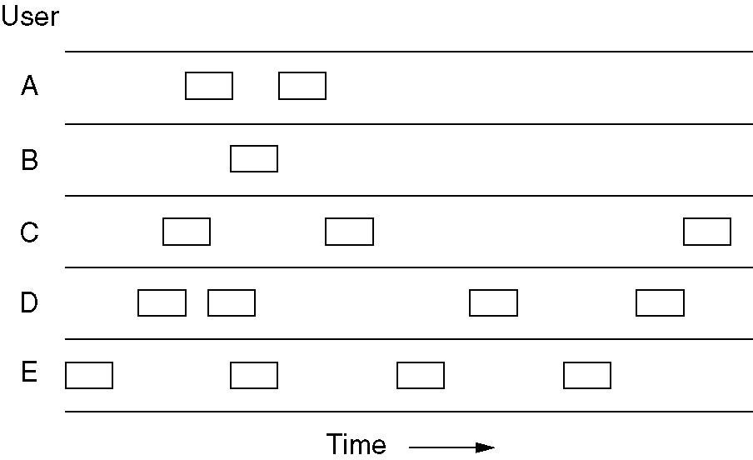
Pure ALOHA
In pure ALOHA, frames are transmitted at completely arbitrary times.

Slide 6
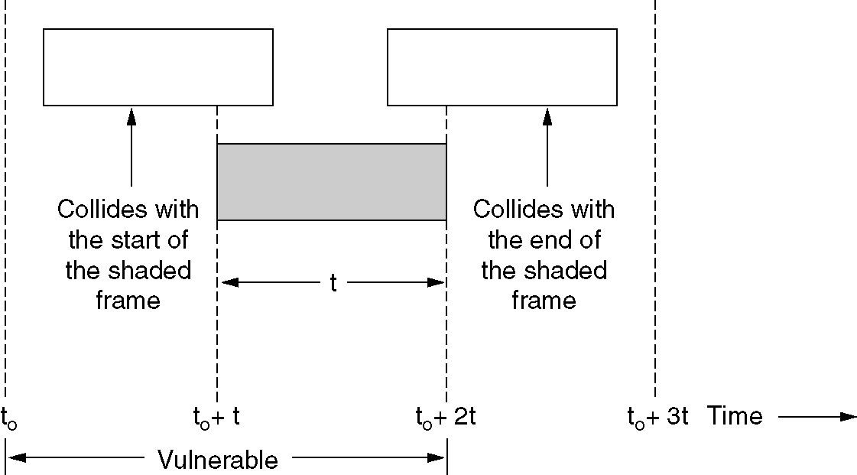
Pure ALOHA (2)
Vulnerable period for the shaded frame.

Slide 7
Multiple Access Protocols
Carrier Sense Multiple Access Protocols(CSMA)
  Protocols in which stations listen for a carrier (i.e., a transmission) and act accordingly are called carrier sense protocols.
  1-persistent CSMA:
    If the channel is busy, the station waits until it becomes idle.
    The protocol is called 1-persistent because the station transmits with a probability of 1 when it finds the channel idle.
    If the first station's signal has not yet reached the second one, the latter will sense an idle channel and will also begin sending, resulting in a collision.
  nonpersistent CSMA:
    if the channel is already in use, the station does not continually sense it for the purpose of seizing it immediately upon detecting the end of the previous transmission.
    Instead, it waits a random period of time and then repeats the algorithm.
  p-persistent CSMA:
    When a station becomes ready to send, it senses the channel. If it is idle, it transmits with a probability p. With a probability q = 1 - p, it defers until the next slot.

Slide 8
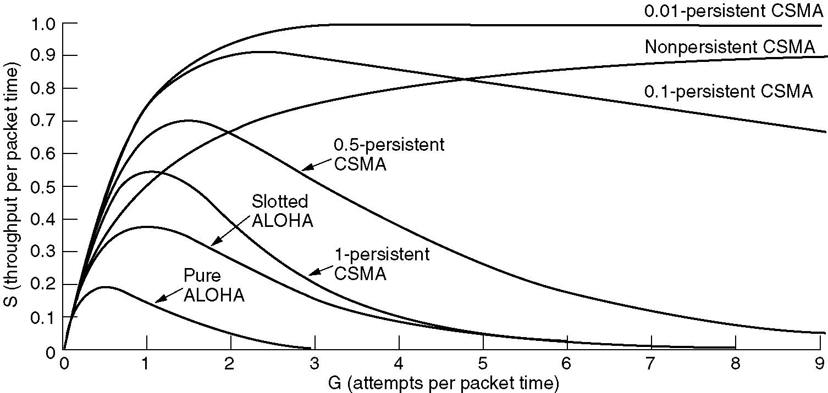
Persistent and Nonpersistent CSMA
Comparison of the channel utilization versus load for various random access protocols.

Slide 9
Multiple Access Protocols
CSMA with Collision Detection (CSMA/CD)
  to abort their transmissions as soon as they detect a collision .
  quickly terminating damaged frames saves time and bandwidth.
  is widely used on LANs in the MAC sublayer.

Slide 10
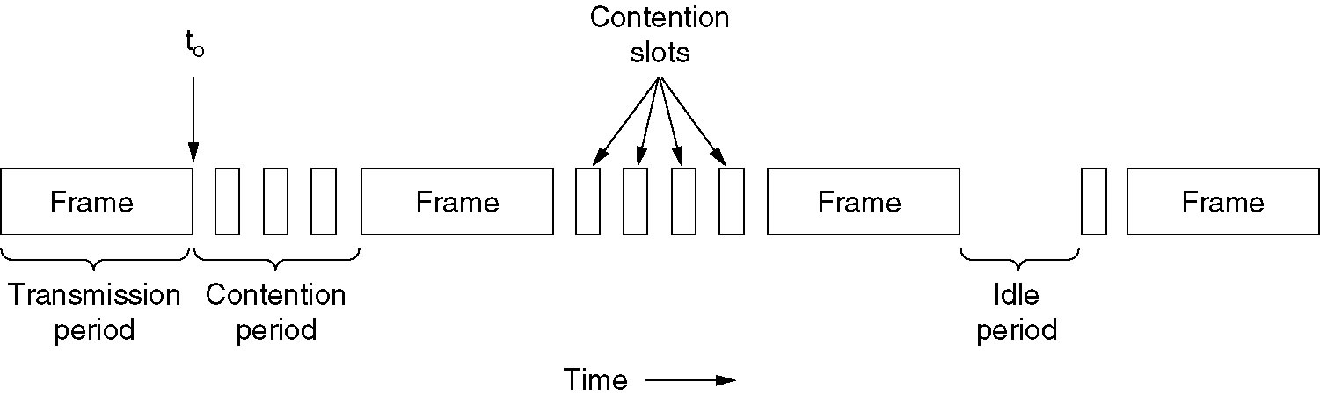
CSMA with Collision Detection
CSMA/CD can be in one of three states: contention, transmission, or idle.

Slide 11
Ethernet
Ethernet Cabling
Manchester Encoding
The Ethernet MAC Sublayer Protocol
The Binary Exponential Backoff Algorithm
Switched Ethernet
IEEE 802.2: Logical Link Control
Retrospective on Ethernet

Slide 12
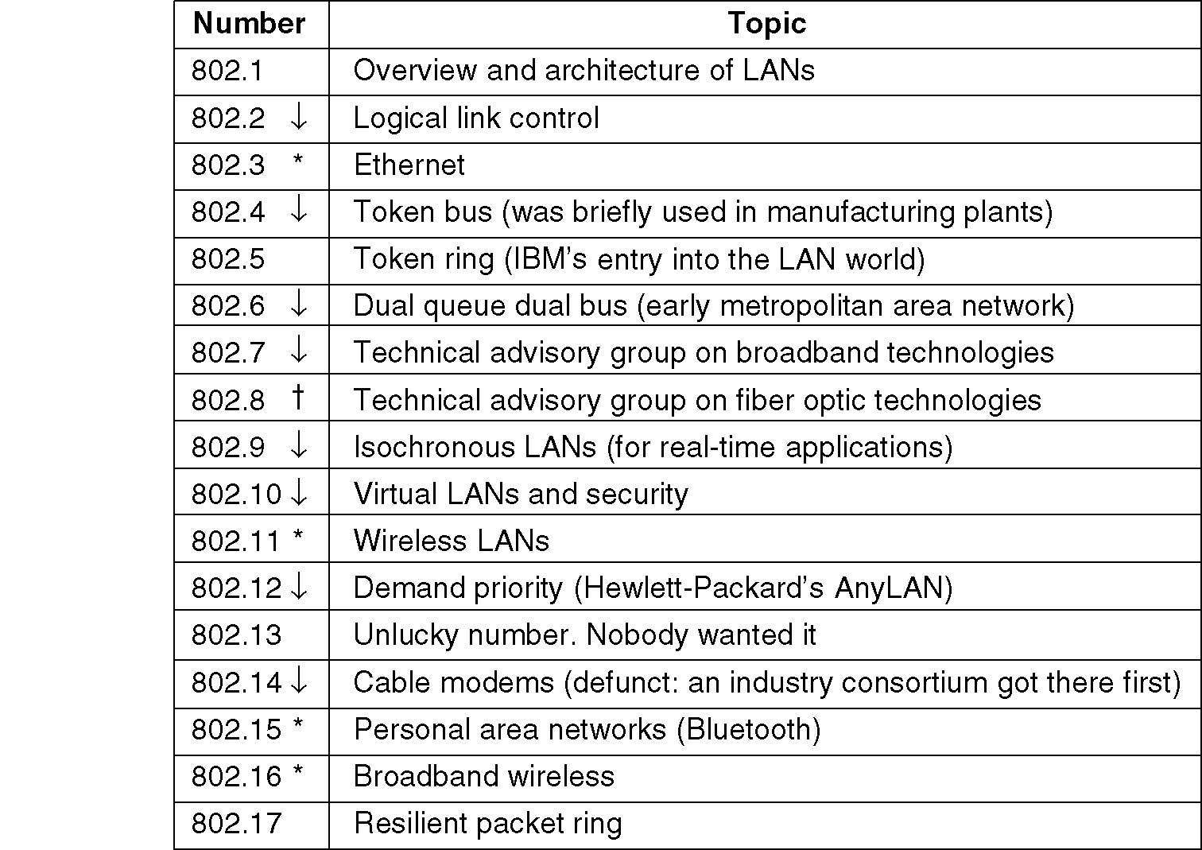
IEEE 802 Standards
The 802 working groups. The important ones are marked with *. The ones marked with ↓ are hibernating. The one marked with † gave up.

Slide 13
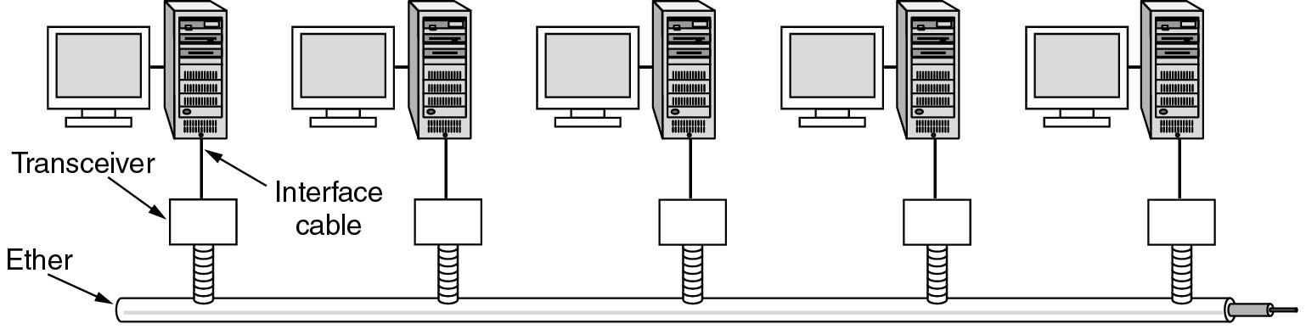
Ethernet
Architecture of the original Ethernet.

Slide 14
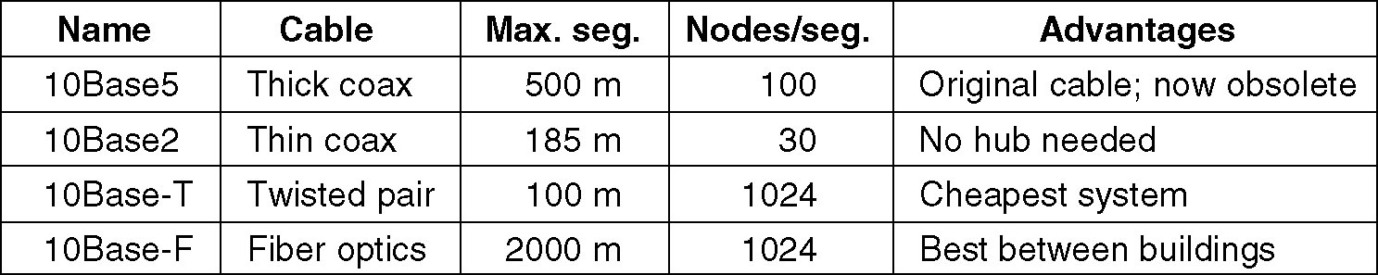
Ethernet Cabling
The most common kinds of Ethernet cabling.

Slide 15
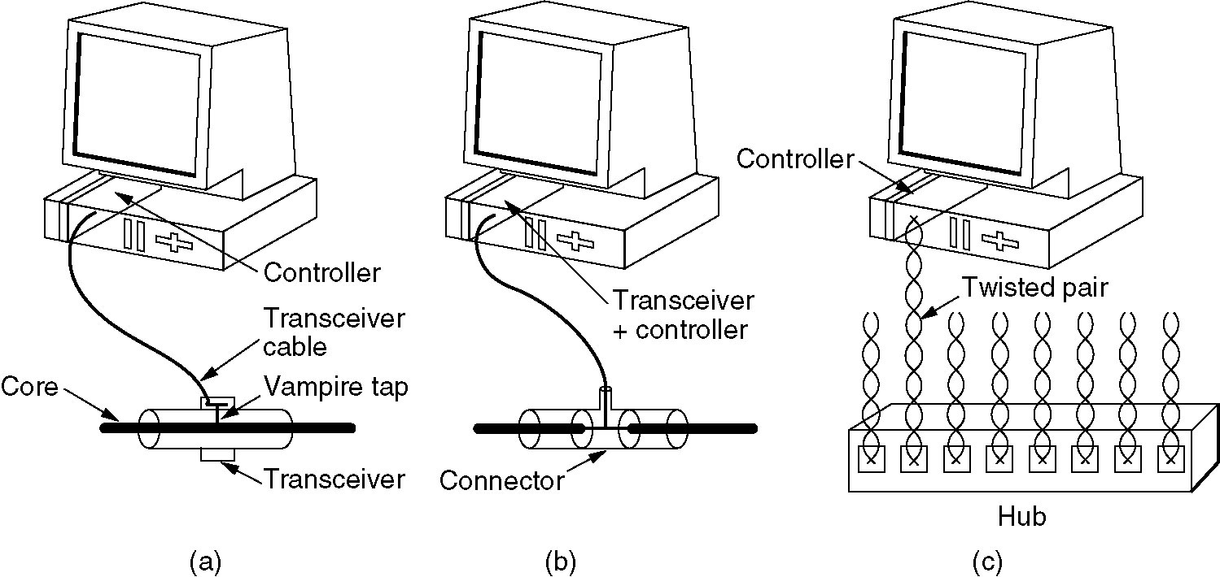
Ethernet Cabling (2)
Three kinds of Ethernet cabling.
(a) 10Base5, (b) 10Base2, (c) 10Base-T.
Notes:
Hub：从一个端口进来的数据都可以从其它端口传出去，只是复制了很多份，没有交换功能；
如果两个机器同时接到Hub上发生数据，那么会造成信息发送冲突

Slide 16
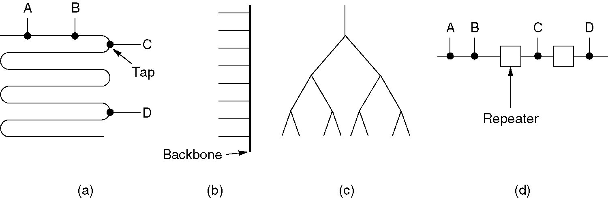
Ethernet Cabling (3)
Cable topologies. (a) Linear, (b) Spine, (c) Tree, (d) Segmented.
A repeater is a physical layer device. It receives, amplifies (regenerates), and retransmits signals in both directions.

Slide 17
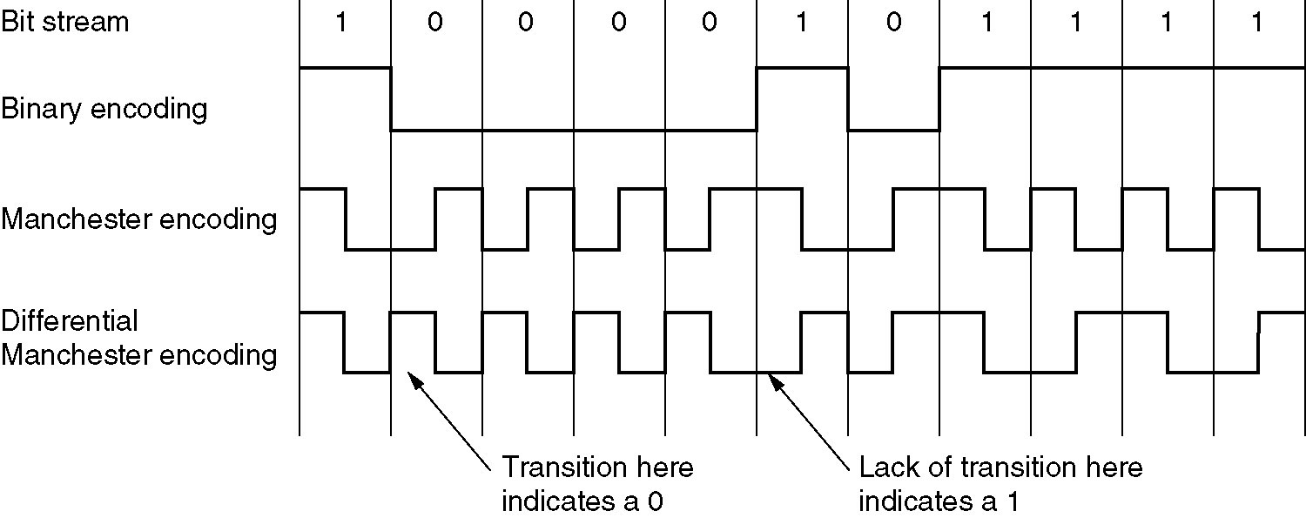
Ethernet Coding
(a) Binary encoding, (b) Manchester encoding,
(c) Differential Manchester encoding.

Slide 18
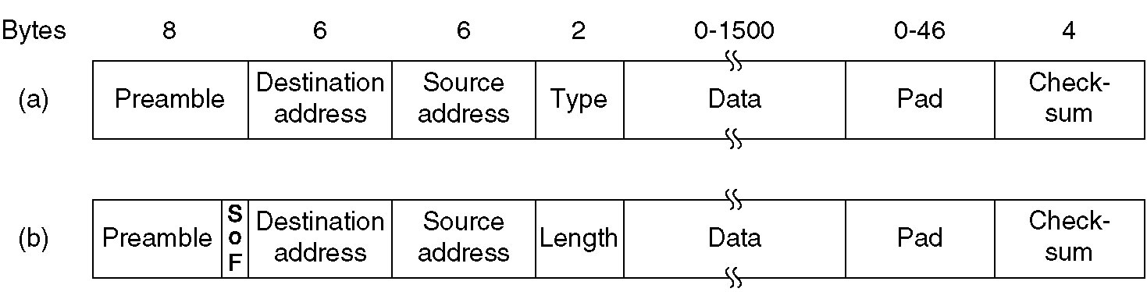
Ethernet MAC Sublayer Protocol
Frame formats. (a) DIX Ethernet, (b) IEEE 802.3.
Notes:
以太网中有介质传输控制层
网卡的物理地址是固化在网卡上的；如果计算机上网可以配置动态IP，在不同的地方上网都会有一个新的IP，这个过程中网卡的物理地址是不会发生变化的。
IP地址：用来标志使用该地址 的计算机是连在哪个网上的；作用是让计算机网络的网络层能找到这台计算机在什么地方
Mac地址：在一个局域网内找计算机的地方
如果在一个局域网（比如校园网）内向校园网外发送数据，则源地址是发送数据的计算机的网卡地址，目的地址是校园网的网卡地址， 在帧的DATA部分的目的地址是校园网外接受数据的计算机的网卡；

Slide 19
Ethernet encapsulation(RFC894) :
46 - 1500
destination
addr.
source
addr.
type
data
CRC
6
6
2
46 - 1500
4
type
0800
IP datagram
2
46 - 1500
type
0806
ARP request/reply
PAD
2
28
18
type
8035
RARP request/reply
PAD
2
28
18
IEEE 802.2/802.3 encapsulation(RFC 1042):
802.3 MAC
802.2 LLC
802.2 SNAP
destination
addr.
source
addr.
length
DSAP
AA
SSAP
AA
cntl
org code
00
type
data
CRC
6
6
2
1
1
1
3
2
38 - 1492
4
type
0800
IP datagram
2
38 - 1492
type
0806
ARP request/reply
PAD
2
28
10
type
8035
RARP request/reply
PAD
2
28
10
IEEE 802.2/802.3 encapsulation(RFC 1042) and Ethernet encapsulation(RFC894)
Notes:
如果type取值是0800，则这个包是网络层IPV4协议包，IPV6是？；Type是用来标志这个数据是什么协议的数据的
如果是0806，则帧里面携带的数据是ARP（地址解析协议）协议的，找到一个IP地址对应的Mac地址，知道IP，不知道网卡目的地址，可通过该协议找到对应的Mac地址
8035是RARP协议的；
IEEE：国际电子工程师协议，802.2/802.3（有线网络下的局域网）封装，要和以太网兼容
当网卡缺省时就安装以太网的标准

Slide 20
=1: for Ethernet
= 0x0800: for IP address
hard size
prot size
= 0x0806
=1: ARP request; =2: ARP reply (2);
=3: RARP request; =4: RARP reply
Ethernet
destination
addr
Ethernet
source
addr
frame
type
hard
type
prot
type
op
Sender
Ethernet
addr
sender
IP addr
target
Ethernet
addr
target
IP addr
6
6
2
2
2
1
1
2
6
4
6
4
Ethernet header
28 bytes ARP request/reply
Figure 4.3 Format of ARP request or reply packet when used on an Ethernet
The special Ethernet destination address of all one bits means the broadcast address.
Notes:
Op：如果字段等于1就是ARP请求消息；等于2是ARP响应消息；3是RARP请求消息；4是RARP响应消息

Slide 21
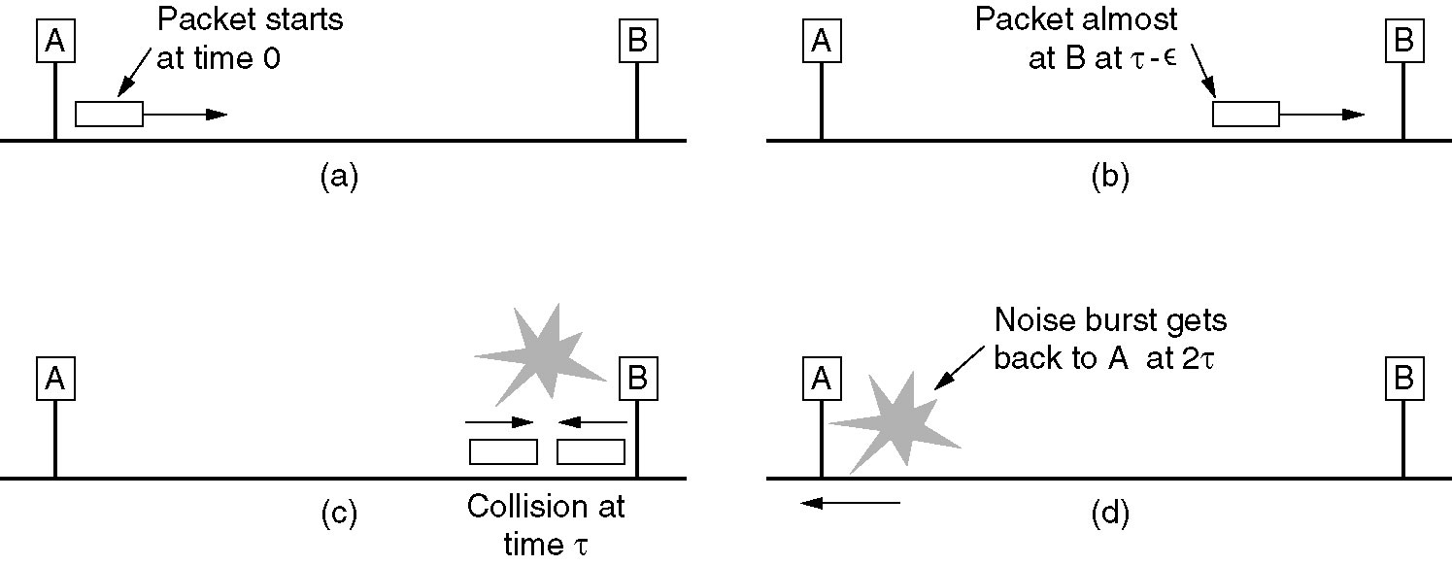
Ethernet MAC Sublayer Protocol (2)
Notes:
A信号快传到B时，B认为没有数据发送，可能就会发数据；然后B发出的数据会对A发送的数据进行干扰；
然后A会判断自己发送的数据是否受到干扰：发出数据的同时，监测信路上的信号；如果二者相等，就没有受到干扰
如果A把数据包发在路上了，B把数据包发到A那里的路上，那么A是判断不出是否受到干扰的；
所以A需要发送长一点的数据，这样当B发送数据到A那里时，A的数据还没有发完，才可以监测到是否受到干扰；
A+B发送时间为2T，则A最好发送时间为2T？
所以千兆网上的计算机不能直接连到线路上，两个机器不能直连，应该通过交换机

Slide 22
The Binary Exponential Backoff Algorithm
After a collision, time is divided into discrete slots whose length is equal to the worst-case round-trip propagation time on the ether (2t).
After the first collision, each station waits either 0 or 1 slot times before trying again.
In general, after i collisions, a random number between 0 and 2^{i} - 1 is chosen, and that number of slots is skipped.
However, after ten collisions have been reached, the randomization interval is frozen at a maximum of 1023 slots. After 16 collisions, the controller throws in the towel and reports failure back to the computer. Further recovery is up to higher layers.

Slide 23
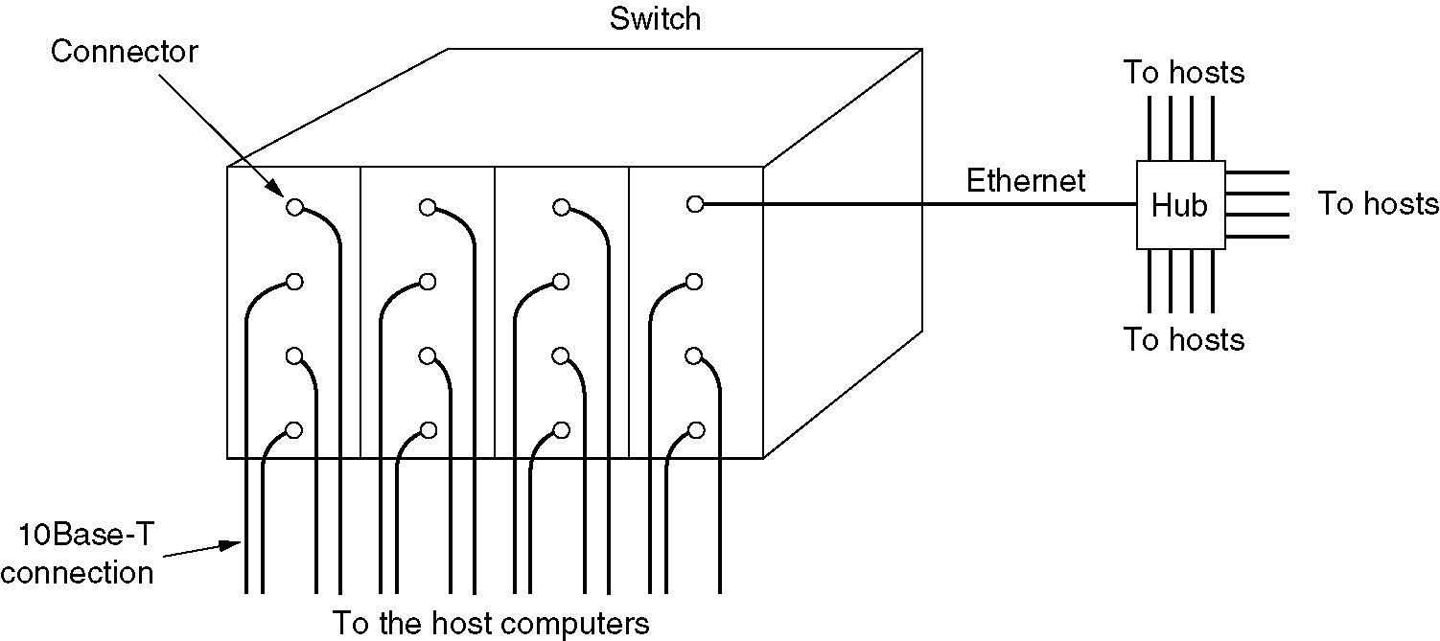
Switched Ethernet交换机
A simple example of switched Ethernet.

Slide 24
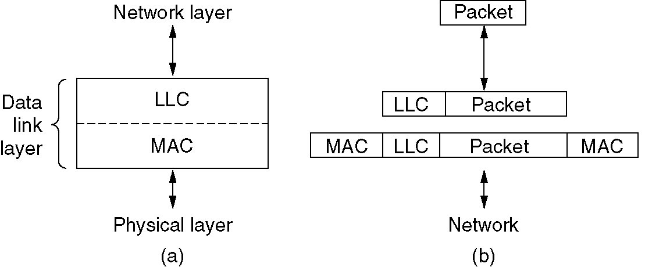
IEEE 802.2: Logical Link Control
(a) Position of LLC. (b) Protocol formats.
LLC provides three service options: 1）unreliable datagram service, 2）acknowledged datagram service, and 3）reliable connection-oriented service.

Slide 25
Retrospective on Ethernet
Longevity
  Simple and flexible, cheap, easy to maintain
  Ethernet interworks easily with TCP/IP
  Speeds of Ethernet have gone up by several orders of magnitude and hubs and switches have been introduced, but these changes have not required changing the software.

Slide 26
Data Link Layer Switching
Bridges from 802.x to 802.y
Local Internetworking
Spanning Tree Bridges
Remote Bridges
Repeaters, Hubs, Bridges, Switches, Routers, Gateways
Virtual LANs

Slide 27
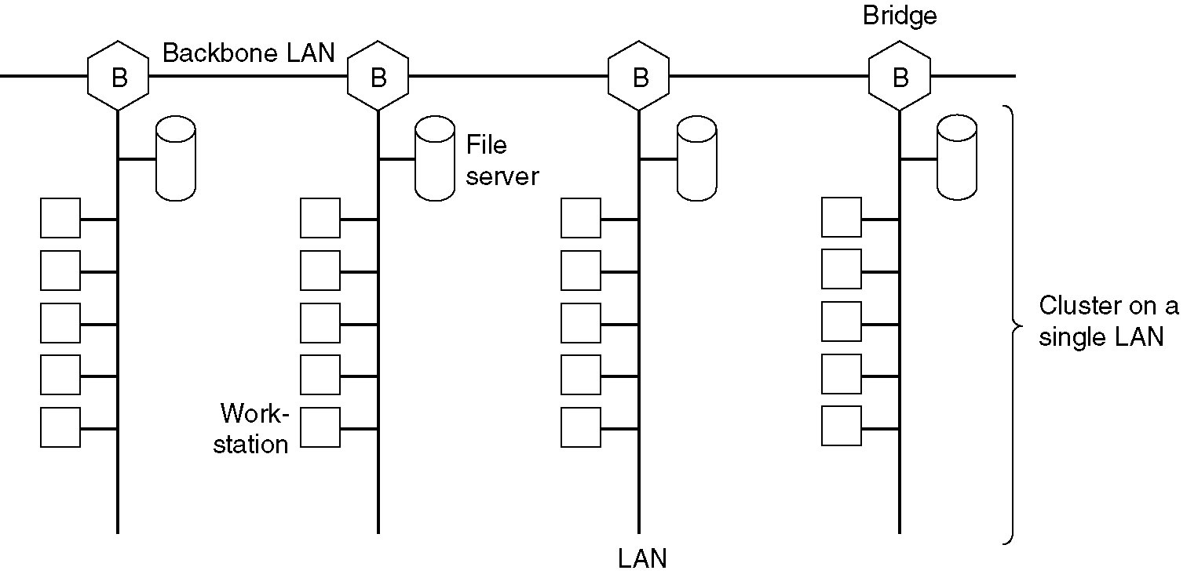
Data Link Layer Switching
Multiple LANs connected by a backbone to handle a total load higher than the capacity of a single LAN.
Notes:
B是桥接器bridge和交换机类似
图上的bridge有三个端口，从三个端口的线出去可以连
1.同轴电缆，同轴电缆上连很多计算机（就是下来连了很多方格的那个）
2.连接另一个bridge，每一部分的方格群不会影响到其他部分的方格群，群与群可以同时发送数据，数据之间互不干扰；而方格群群内会有干扰；若一个群内某台机子要发送数据到另一个群内的另一台机子，那么数据先到本群上头的B，然后B往目的群上头的B发（从一个端口进，另一个端口出，交换机内有转发表的），之后再往下走到目的机子
3.接了其他设备，子网啊什么的
B1会把收到的数据从3个端口往外发，B2,3,4都会往外发，进而可以把数据传送到目的地
交换机里有地址转化表
交换机有学习功能，表之前是空的，一旦转发帧的功能的过程中学习到了mac地址和端口号，就记录下来，之后再转发时就不需要广播（向每个端口问是谁需要这个消息），而是直接从地址转发表中读取进行转发

Slide 28
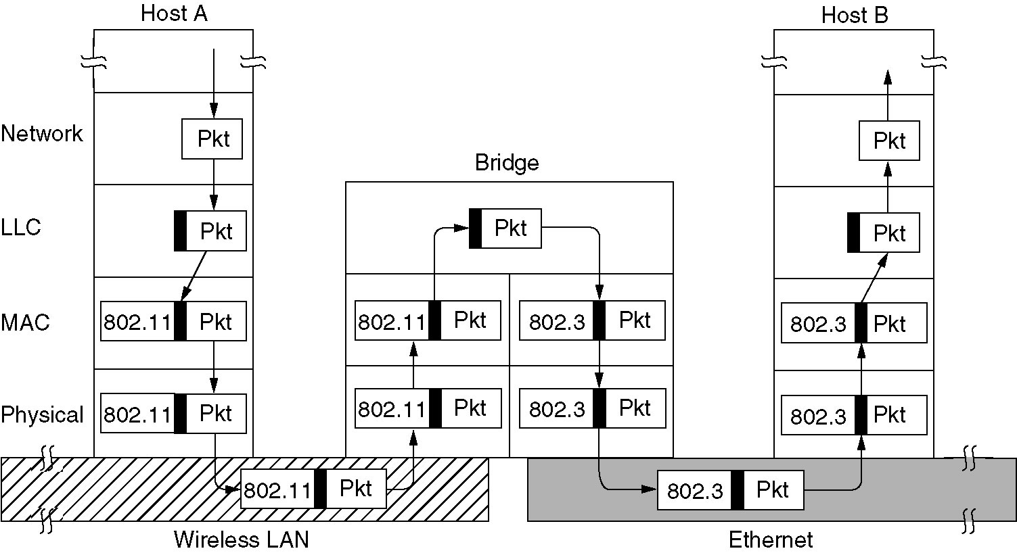
Bridges from 802.x to 802.y
Operation of a LAN bridge from 802.11 to 802.3.
Notes:
Bridge：网关，有两个网卡，一个有限以太网卡一个无限局域网卡，需要做消息格式的转换，把有限的转为无限的帧

Slide 29
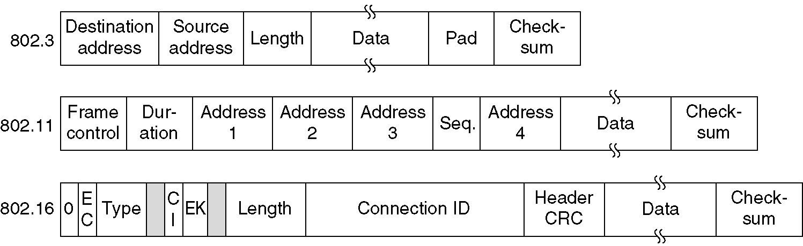
Bridges from 802.x to 802.y (2)
The IEEE 802 frame formats. The drawing is not to scale.

Slide 30
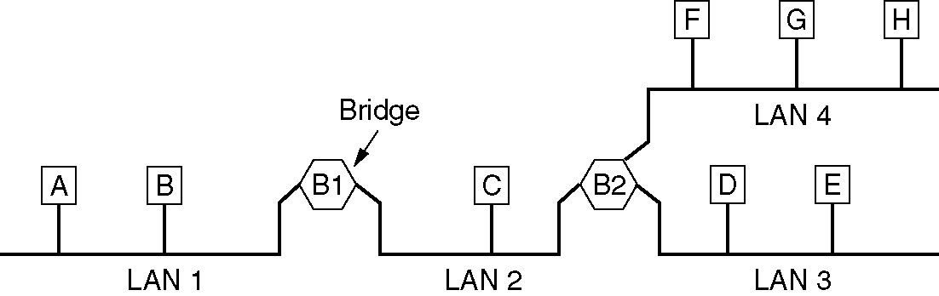
Local Internetworking
A configuration with four LANs and two bridges.

Slide 31
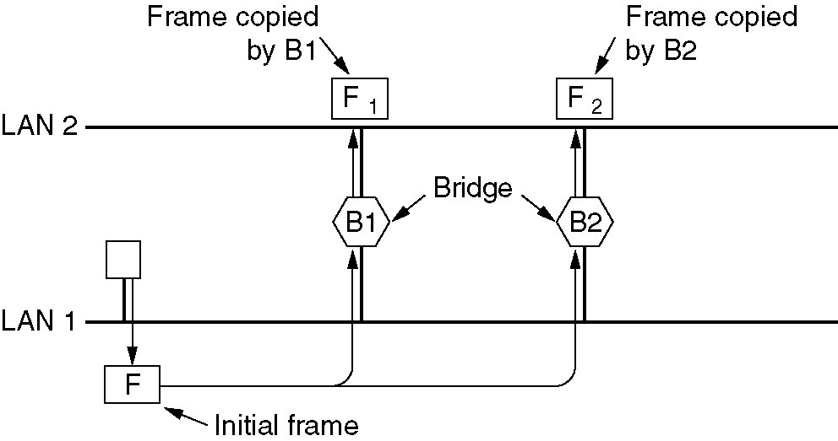
Spanning Tree Bridges
Two parallel transparent bridges.
Notes:
把两个局域网连接起来，在两个局域网中间用了两个交换机（网桥），这样一个坏了，另一个还能用
在网络刚启动时，LAN1要发送一个包，要发到第二个局域网上，这个包会被B1接收，然后它会把消息往F1上发；F1发到F2，F2到B2，而刚刚启动时，转换表是空的，
这样B2会发到B1，这样造成循环发送；
解决方法：
生成树协议

Slide 32
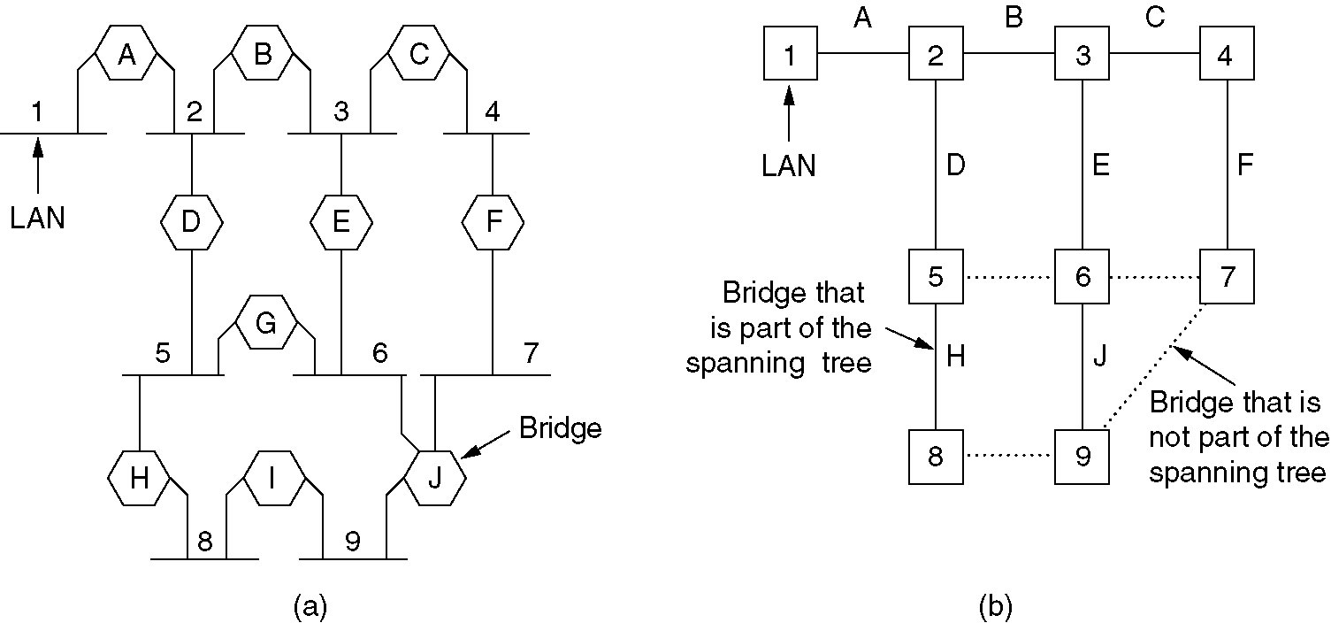
Spanning Tree Bridges (2)
(a) Interconnected LANs. (b) A spanning tree covering the LANs. The dotted lines are not part of the spanning tree.
Notes:
如果在局域网中传视频，（实时消息），就要求速度快，所以需要更好的协议，更快的算法

Slide 33
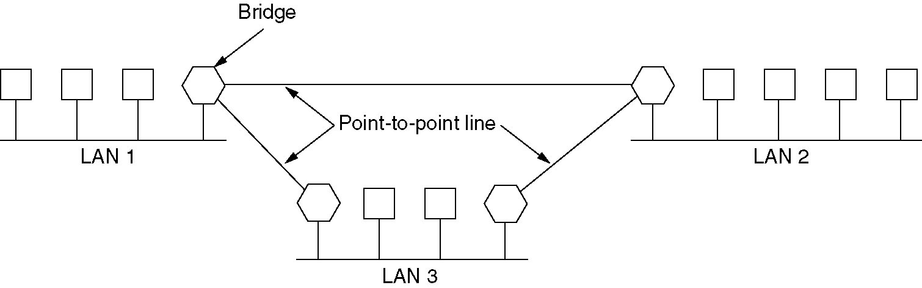
Remote Bridges
Remote bridges can be used to interconnect distant LANs.

Slide 34
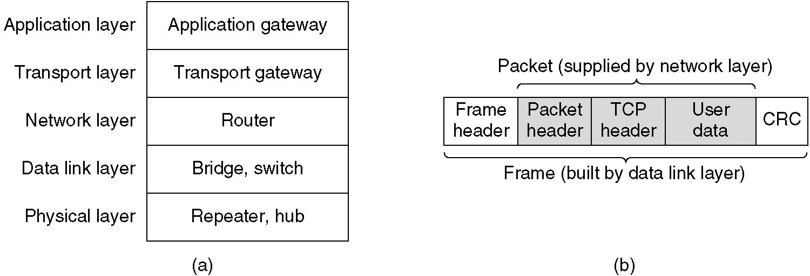
Repeaters, Hubs, Bridges, Switches, Routers and Gateways
(a) Which device is in which layer.
(b) Frames, packets, and headers.
Notes:
A图：
Router路由器是第三层设备；
交换机和网桥是根据帧里的目的地址转发帧的，不管帧里装的是IP包还是别的什么
Repeater：使两个计算机最大的传送距离变成4个500米？
传输层网关：把两个不同的网络连接起来，要把OS？和TCPiP连接，这两个协议是不一样的，要让这两个网的计算机可以通信，就必须要进行传输层协议的转换
应用层网关：
WiFi：无线的信号传输，和有线不一样，然后他不讲了= =

Slide 35
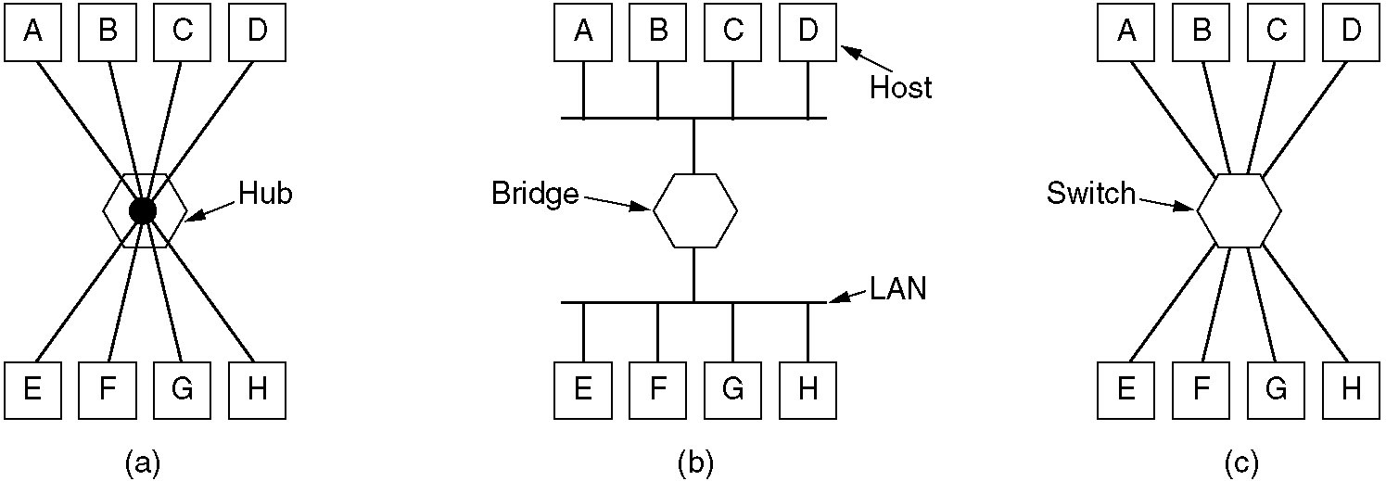
Repeaters, Hubs, Bridges, Switches, Routers and Gateways (2)
(a) A hub. (b) A bridge. (c) a switch.

Slide 36
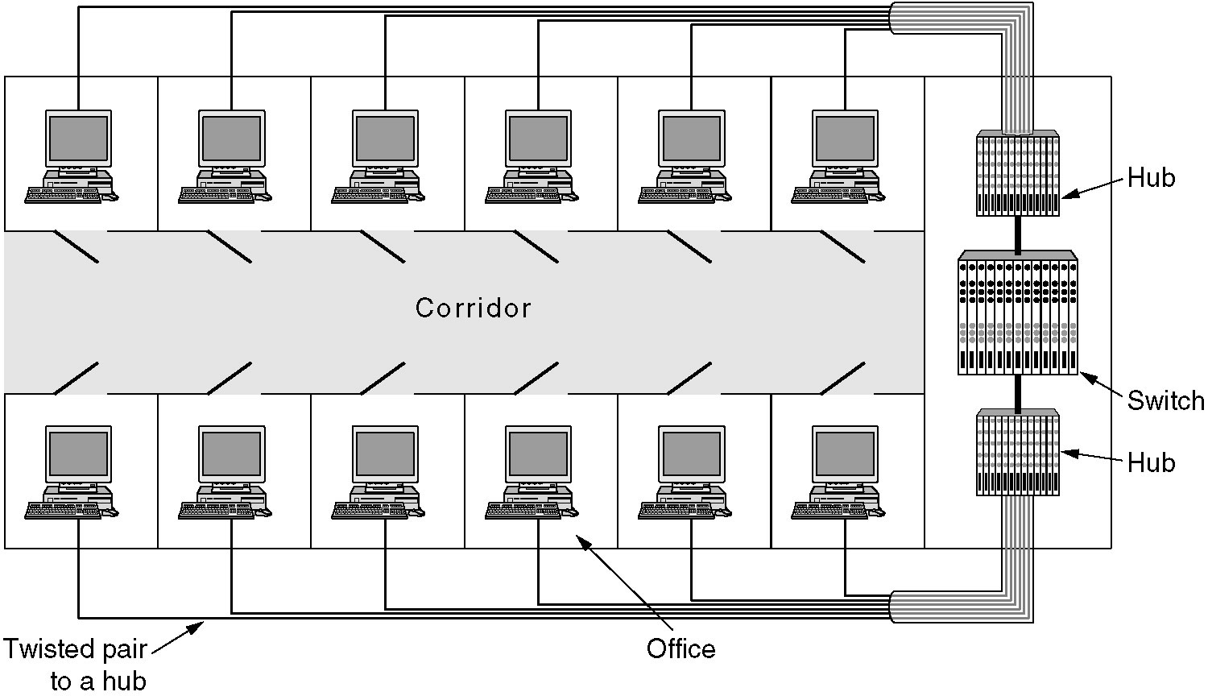
Virtual LANs
A building with centralized wiring using hubs and a switch.

Slide 37
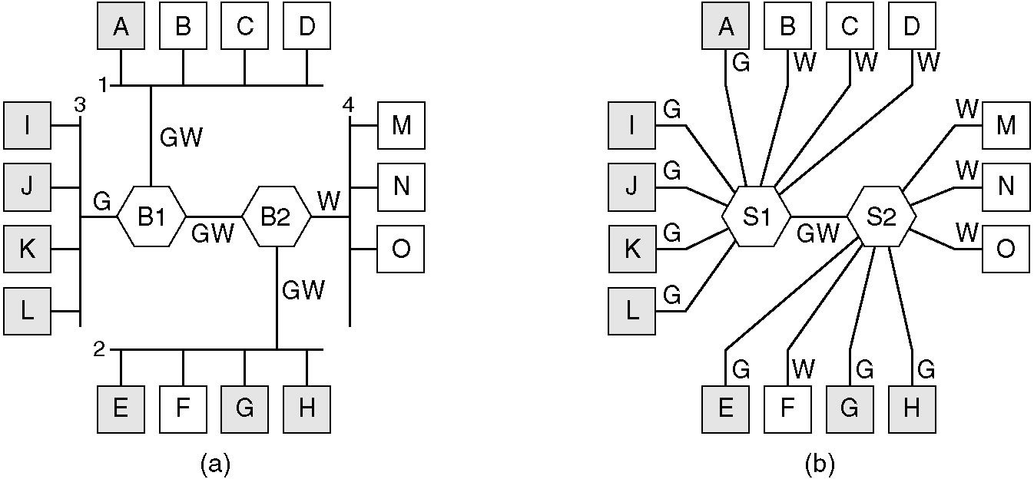
Virtual LANs (2)
(a) Four physical LANs organized into two VLANs, gray and white, by two bridges.
(b) The same 15 machines organized into two VLANs by switches.

Slide 38
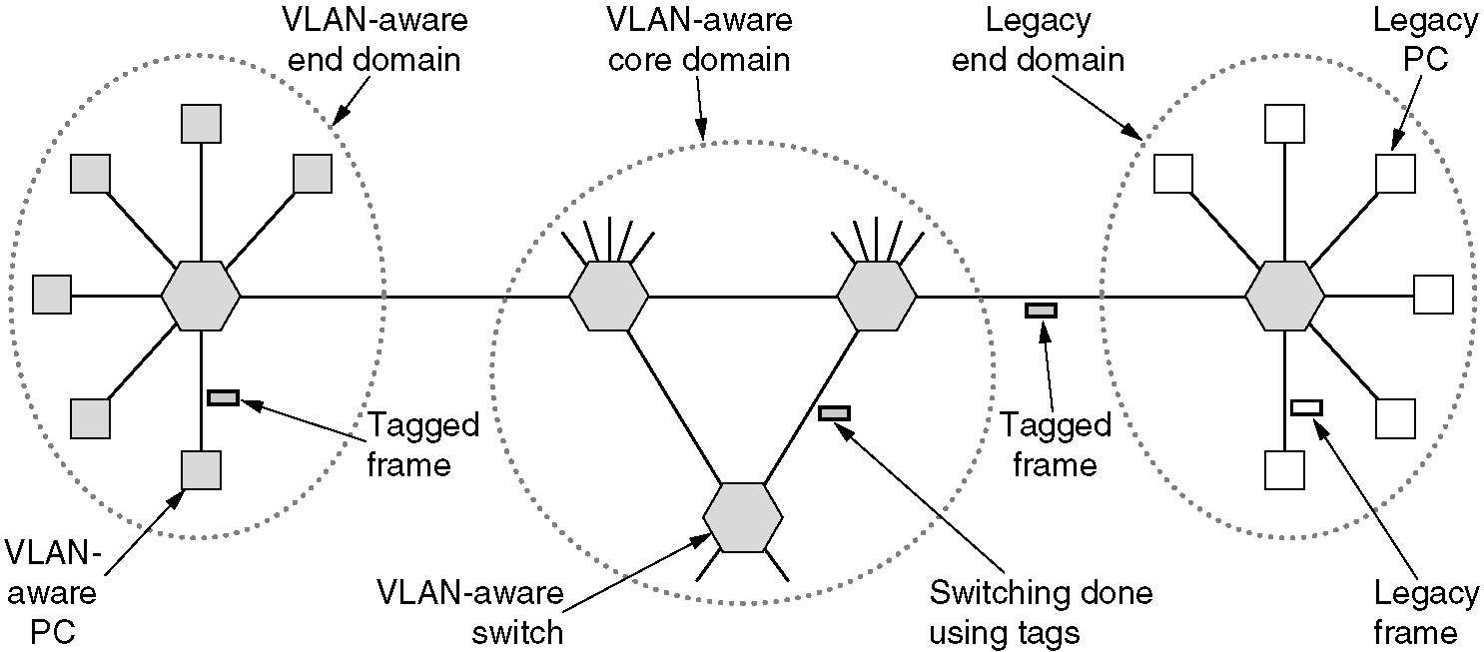
The IEEE 802.1Q Standard
Transition from legacy Ethernet to VLAN-aware Ethernet. The shaded symbols are VLAN aware. The empty ones are not.

Slide 39
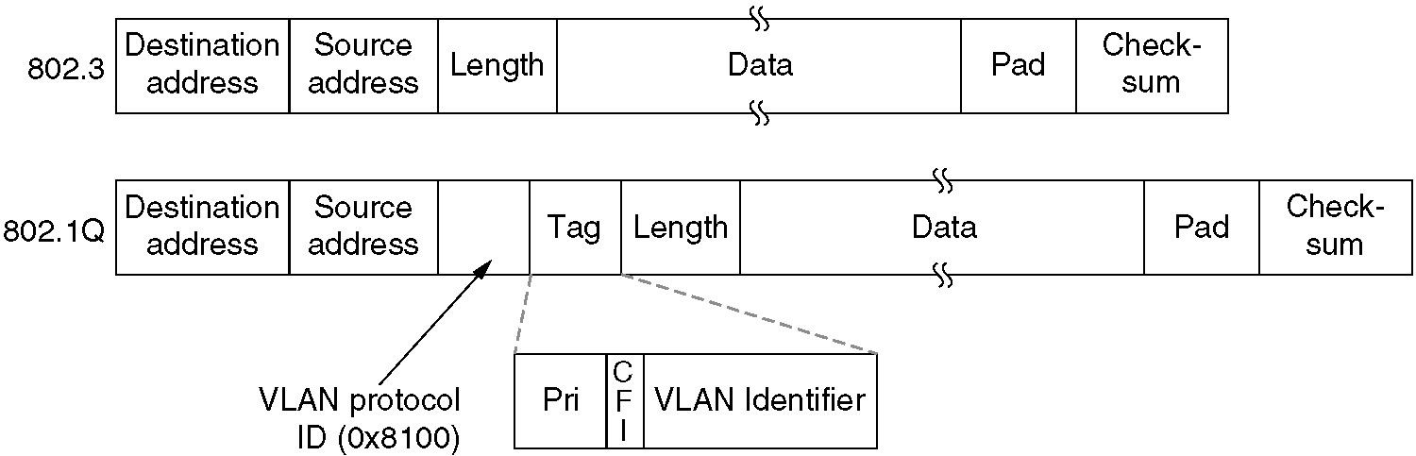
The IEEE 802.1Q Standard (2)
The 802.3 (legacy) and 802.1Q Ethernet frame formats.

Slide 40
Summary
Why is MAC sublayer needed?
Multiple access protocols: principles, and protocol procedure
  Pure ALOHA, Slotted ALOHA
  CSMA: 1-persistent, nonpersistent, p-persistent
  CSMA/CD
Ethernet
  Ethernet cabling, coding
  MAC sublayer protocol, frame format
  Repeater/Hub, Bridge/Switch
  Spanning Tree: why, how
  VLAN: Why?

